Slide 1
Using views to build queries

Slide 2
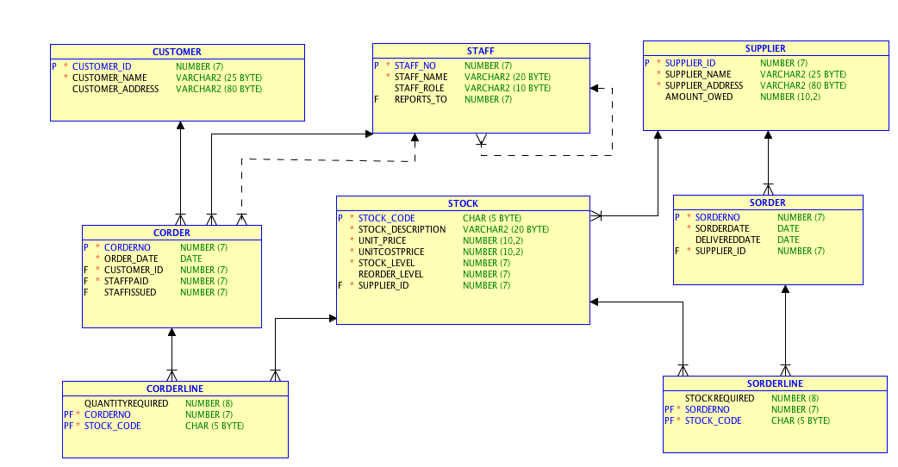
Who bought what?

Slide 3
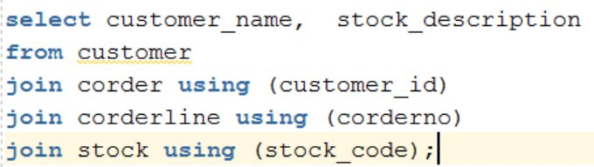
Who bought what?
To find a list of the customers who bought a specific item, I would need:

Slide 4
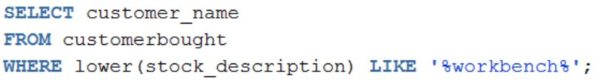
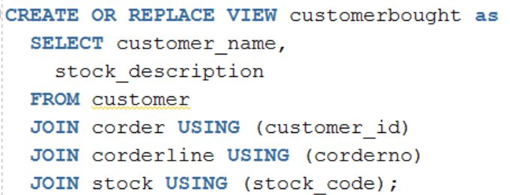
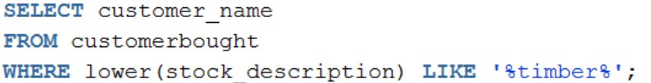
Build the queries using views
A
B

Slide 5
Using Views
What about :
  Customers who bought a workbench but no timber? (A – B)
  Customers who bought timber but no workbench? (B – A)
  Customers who bought both timber and a workbench? (A ∩ B)
  Customers who bought either timber or a workbench? (A U B)
  Customers who bought either timber or a workbench, but not both?
    A xor B (A U B) - (A ∩ B)
  Customers who only bought a workbench? (A - ¬A)

Slide 6
More complex relationships

Slide 7
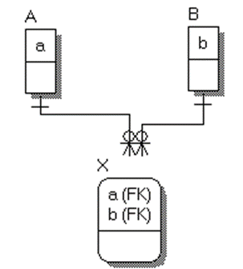
What is the shape of our tables?
ERDs start to get complex when there are many:many relationships.
  Consumers eating types of crisp
  Students sitting modules
  Customers buying stock
We can use SET theory to form a template for common queries.

Slide 8
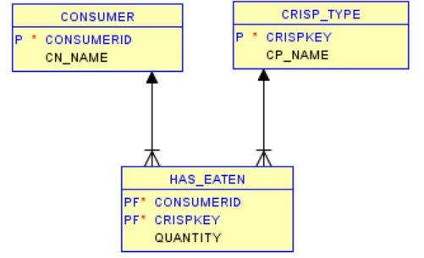
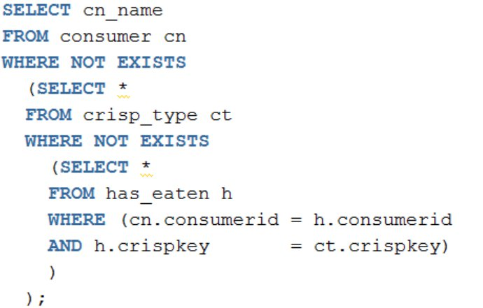
Who ate every type of crisp?
A
B
nonkeyvalue
A
a
b
B
nonkeyvalue
X
a
X
b
Return names of consumers
where there is no type of crisp
they haven’t eaten

Slide 9
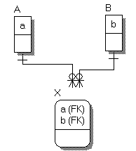
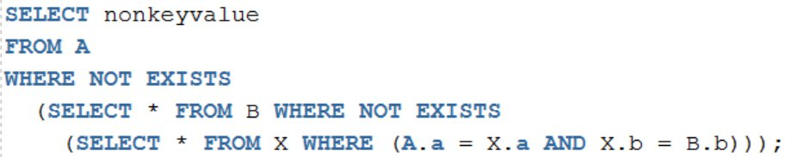
Helping the divide
If I want a list of nonkey values in A for rows that are associated with all occurrences of B:

Slide 10
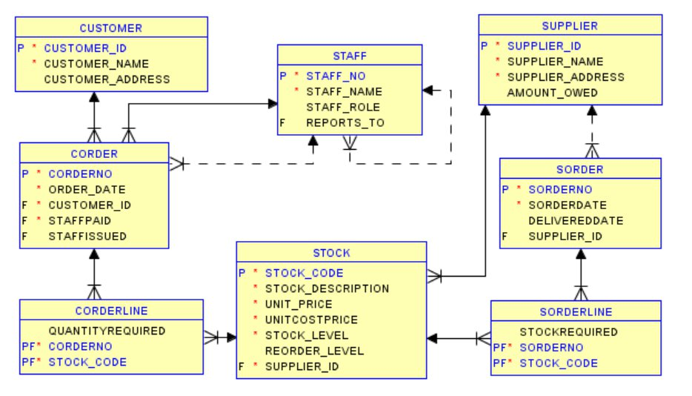
Slightly more obscure…
A.a
B
A
Nonkey value
Who bought all the stock items supplied by Buckleys?
Where are A, X and B?
  A must be a table or view with the identifying key to customer name, joined to X.
  B must be a table or view with the identifying key to the stock items supplied by Buckleys, joined to X.
  X must be a weak entity, with a many:1 link to A and to B.
X
X.a
X.b
B.b

Slide 11
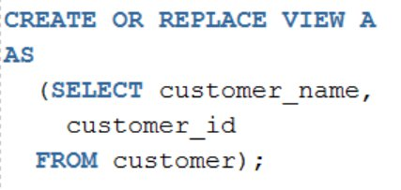
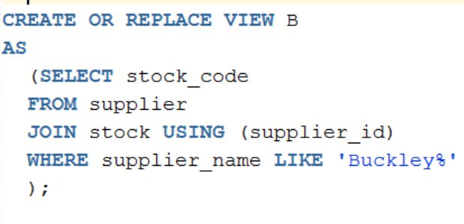
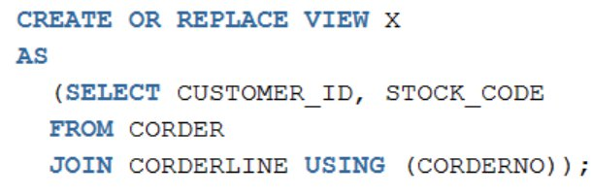
The views…
B
A
X

Slide 12
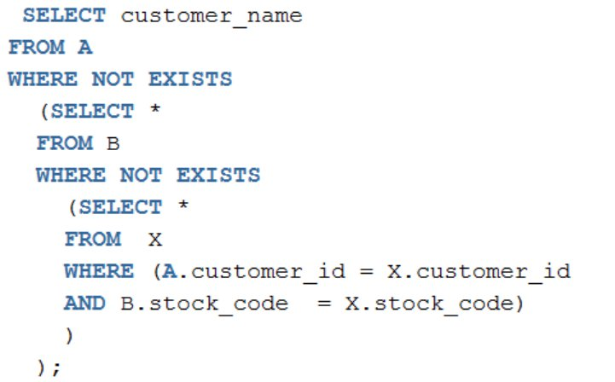
The final query
B
A
X

